Slide 1
Lecture 11 Correlation and Covariance
16/08/2023

Slide 2
Covariance
In statistics and probability theory, covariance deals with the joint variability of two random variables: x and y.
Generally, it is treated as a statistical tool used to define the relationship between two variables.
Covariance is a measure of the relationship between two random variables and to what extent, they change together. Or we can say, in other words, it defines the changes between the two variables, such that change in one variable is equal to change in another variable.
This is the property of a function of maintaining its form when the variables are linearly transformed.
Covariance is measured in units, which are calculated by multiplying the units of the two variables

Slide 3
Types of Covariance
Positive Covariance
If the covariance for any two variables is positive, that means, both the variables move in the same direction. Here, the variables show similar behaviour. That means, if the values (greater or lesser) of one variable corresponds to the values of another variable, then they are said to be in positive covariance.
Negative Covariance
If the covariance for any two variables is negative, that means, both the variables move in the opposite direction. It is the opposite case of positive covariance, where greater values of one variable correspond to lesser values of another variable and vice-versa

Slide 4
Covariance formula
Covariance formula is a statistical formula, used to evaluate the relationship between two variables.
It is one of the statistical measurements to know the relationship between the variance between the two variables.
Let us say X and Y are any two variables, whose relationship has to be calculated.
Thus the covariance of these two variables is denoted by Cov(X,Y).

Slide 5
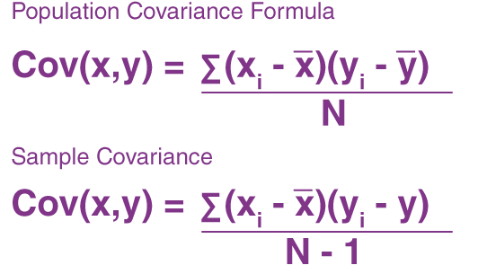
Covariance Formula
Where,
xi = data value of x
yi = data value of y
x̄ = mean of x
ȳ = mean of y
N = number of data values.

Slide 6
Example: Calculate the coefficient of covariance for the following data:
X | 2 | 8 | 18 | 20 | 28 | 30
Y | 5 | 12 | 18 | 23 | 45 | 50
Number of observations = 6
Mean of X = 17.67
Mean of Y = 25.5
Cov(X, Y) = (⅙) [(2 – 17.67)(5 – 25.5) + (8 – 17.67)(12 – 25.5) + (18 – 17.67)(18 – 25.5) + (20 – 17.67)(23 – 25.5) + (28 – 17.67)(45 – 25.5) + (30 – 17.67)(50 – 25.5)]
= 157.83

Slide 7
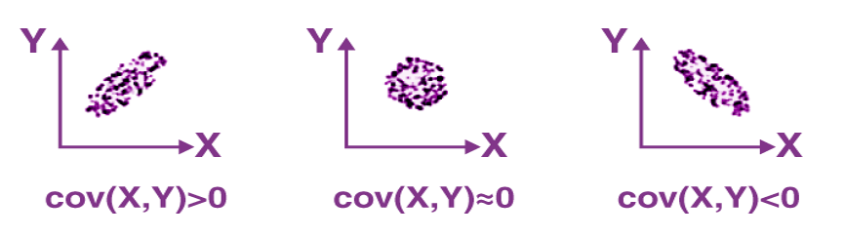
Interpretations Covariance

Slide 8
Interpretations Covariance
If cov(X, Y) is greater than zero, then we can say that the covariance for any two variables is positive and both the variables move in the same direction.
If cov(X, Y) is less than zero, then we can say that the covariance for any two variables is negative and both the variables move in the opposite direction.
If cov(X, Y) is zero, then we can say that there is no relation between two variables.

Slide 9

Correlation Coefficient & Formula
Correlation estimates the depth of the relationship between variables. It is the estimated measure of covariance and is dimensionless. In other words, the correlation coefficient is a constant value always and does not have any units. The relationship between the correlation coefficient and covariance is given by:
ρ(X,Y) = correlation between the variables X and Y
Cov(X,Y) = covariance between the variables X and Y
σX = standard deviation of the X variable
σY = standard deviation of the Y variable

Slide 10
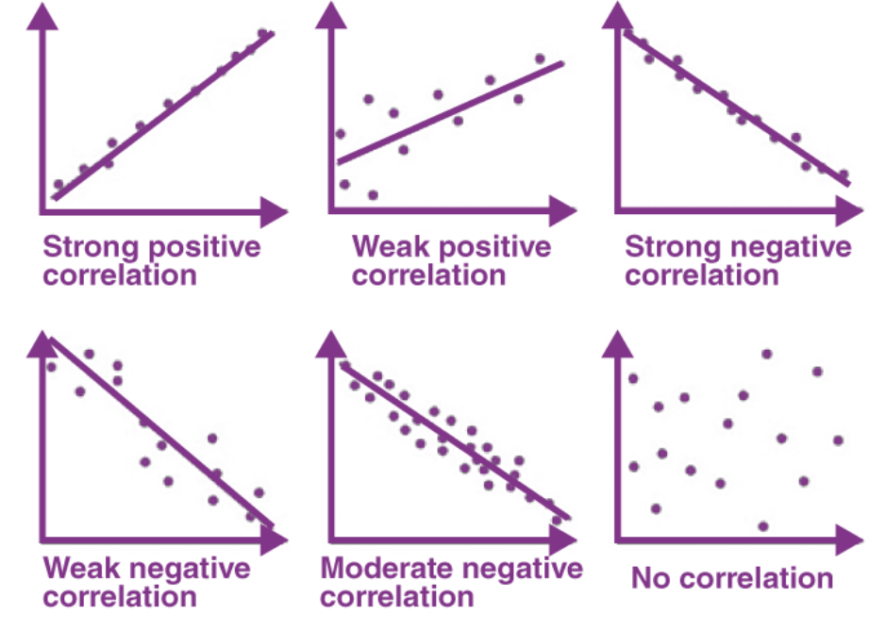
Graphical representation of correlation among two variables

Slide 11
Difference Between Covariance-Correlation
Covariance | Correlation
It is a measure to show the extent to which given two random variables change with respect to each other. | It is a measure used to describe how strongly the given two random variables are related to each other.
It is a measure of correlation. | It is defined as the scaled form of covariance.
The value of covariance lies between -∞ and +∞. | The value of correlation lies between -1 and +1.
It indicates the direction of the linear relationship between the given two variables. | It measures the direction and strength of the linear relationship between the given two variables.

